Slide 1
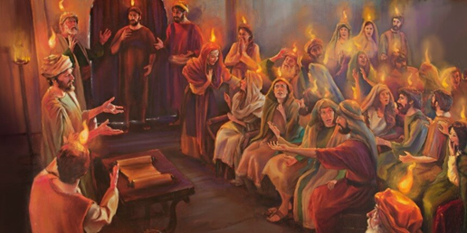
Jesus gives his Spirit
R-1
S-01
Notes:
Slide 1 Jesus gives his Spirit
Use this slide as a focussing strategy to introduce the resource topic. Read the title together and invite children to share something they know about the Feast of Pentecost and how the life of the Spirit continues in the followers of Jesus today.
Use the Scripture stories about Pentecost during class prayer this week.
Teacher’s Note
For Slide 5 you will need a red, yellow or white ribbon or streamer of crepe paper long enough to pass around your class circle.

Slide 2
Learning Intentions
The students will:
1)
recognise that Pentecost brings to fulfilment the Easter story
2)
recognise that it is the same Holy Spirit Te Wairua Tapu at work in the life of the early Church as in the Church today
R-1
S-02
Click the borders to reveal text
Notes:
Slide 2 Learning Intentions
Read through the Learning Intentions with the class and identify some ideas/questions that might be explored in the resource.

Slide 3
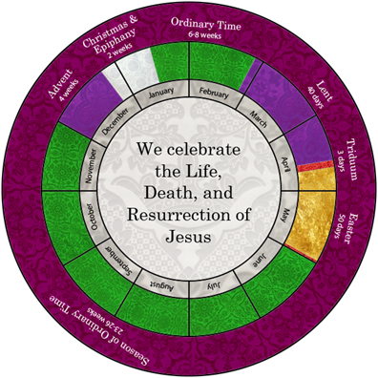
The Feast of Pentecost within the Liturgical Year – one part of a bigger story
Look at the Liturgical Calendar and locate where the Feast of Pentecost is.
Name the season it completes.
What was the important event for Jesus after this season that had to happen to enable the Holy Spirit to come?
Explain the connection between the Feast of the Ascension and the Feast of Pentecost.
Give reasons for why the colour for Pentecost is red and where this can be seen.
R-1
S-03
Click the video button to play ‘We didn’t start the fire’
Notes:
Slide 3 The Feast of Pentecost within the Liturgical Year – one part of a bigger story
Read and respond to the bullet points on the slide.
1) Pentecost comes between Easter and Ordinary Time.
2) Easter
3) His Ascension to heaven.
4) At his Ascension Jesus promised he would be with his followers always and he would send them his Spirit.
5) Pentecost is red to remind us of the tongues of fire that symbolised the Holy Spirit that hovered about the disciples’ heads. At Pentecost red can be seen in churches on banners, the priest’s vestments and the altar cloths and frontals.

Slide 4
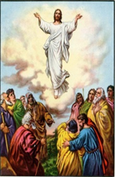
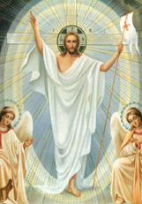
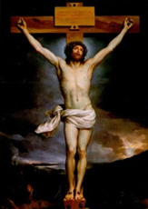
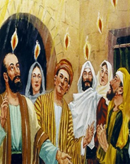
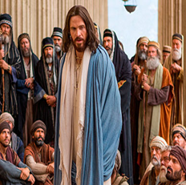
Understanding the connection between Jesus’ life, death and resurrection, his Ascension and the coming of the Holy Spirit at Pentecost
Because of the way he lived his life
Jesus was put to death on the cross
So he could rise again and overcome death and
ascend to God in heaven then keep his promise to
send his Spirit to live in his followers for all time
So that the Spirit could remain
with his followers in his Church
to guide and strengthen them forever.
R-1
S-04
Click the info button to see the connection
Notes:
Slide 4 Understanding the connection between Jesus’ life, death and resurrection, his Ascension and the coming of the Holy Spirit at Pentecost.
Use the I pop up to generate discussion to help the young people to make the connection between the effects of his life, death, resurrection, ascension and Pentecost when he sent his Spirit to fill and guide and strengthen his followers forever.
Explain that really the feasts of Easter, the Ascension and Pentecost are like one big feast stretched out over time. The story is completed by Pentecost and the Holy Spirit keeps it alive in the lives of people in the Church today.

Slide 5
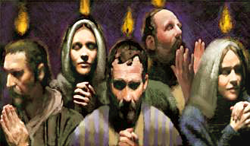
Recalling the parts of the Easter story that led up to Pentecost
Unroll and pass around the ribbon and as it reaches each student she or he tells something to continue the story naming the people and the events in sequence …
The Feasts of the Easter Season are all part of one story. The actual timeframe is unsure but spreading them out over time and celebrating them in their sequence allows people to understand them better and appreciate how they are part of the whole Easter story.
Start with some stories about what Jesus did while he lived on earth and then move to the events of Good Friday, Easter Sunday, the Ascension story and then the Pentecost story. Use the clip on the slide as a summary of the big story and note any parts that have been missed.
Class sit in a circle to get a sense that the stories of Jesus’ life and what happened after it are all part of one big story they …
Click the pins on the right to reveal post-it notes.
Click the video button to play ‘Pentecost in 2 minutes’
R-1
S-05
Notes:
Slide 5 Recalling the parts of the Easter story that led up to Pentecost
Adapt Teaching and Learning Experience 2.
Sit in a class circle with your ribbon or crepe paper.
Starting with recalling events in Jesus’ life, then moving on to Jesus’ death, each student continues to say around the circle the name of a feast in the Easter season in the order they happened.
Read and discuss the post it notes and follow the instructions on post its 3 & 4. Explain the links between the events to show how one event leads to another.
Watch the clip
Pentecost in 2:18 minutes
https://www.youtube.com/watch?v=J5tr4pqWIo4
Repeat the circle activity and add to the comments made in the first round.

Slide 6
Putting the Story of Pentecost and what followed into your own words
When all the sentences are completed, work together to make them into the sequence of the Pentecost story. Add an extra sentence for any important parts that are missing.
Take turns to read aloud Chapter 2 of the Acts of the Apostles.
Put the story onto a background to create a mural and make an appropriate frame. Enlarge and copy the wordle and include it as well.
Look closely at the wordle and choose a word and create a sentence that explains its part in the story. Make the text large enough to display on the wall and highlight the word you chose so it can be identified.
Read, share and display your story in your school and parish.
R-1
S-06
Click the small images to reveal text
Notes:
Slide 6 Putting the Story of Pentecost and what followed into your own words
Use the text prompts on the screen and follow the directions.
Record the outcomes and use it as a resource for future use.
Students share in pairs about their favourite part of the Pentecost story.
Students make their own Pentecost Wordle to share at home.

Slide 7
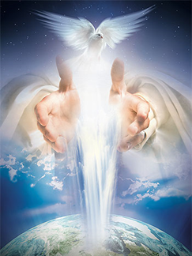
The work of the Holy Spirit Te Wairua Tapu in the Church today
The Spirit that was sent at Pentecost into the first members of the Church is the Spirit of Jesus.
How long ago did this happen?
It was through the Holy Spirit that Jesus brought God’s life, Tapu and Mana, God’s love, peace, justice, healing and reconciliation to people while he lived and worked with his followers on earth.
Can you give an example of how Jesus used these gifts of the Spirit while he worked on earth?
God’s plan was that Jesus would return to heaven after his resurrection to assume his rightful place of glory giving him all power and authority. God planned that Jesus’ Spirit would remain on earth because God would pour the Spirit into Jesus’ disciples so they could carry on the work he had started and they would pass on to others how to use the gifts of the Spirit to build God’s kingdom. Do you believe God’s plan worked – what evidence do you have to support your belief?
The people who followed the teaching of Jesus down through the ages have passed on to others the good news Jesus shared, and acted on his last message to them at his Ascension to spread it to every nation.
Can you think of any other message that has lasted as long as the one Jesus shared?
The people who continue the work today that Jesus started are filled with the same Holy Spirit who filled the disciples at Pentecost. People who show kindness, forgiveness, love, fairness and all the other things Jesus showed are living proof that God’s plan worked.
What can young people of your age do to show that you have the Spirit of Jesus working in you today?
Who are the disciples of Jesus who have shared his message and passed on how to use the gifts of his Spirit to you? How has this message changed the way you live, how you treat people and how is it is shaping the values you have and the person you are becoming? Take time to consider this carefully it is very important – listen to the Spirit speaking to you in your heart, reminding you, encouraging you, prompting you and helping you to have fun and be joyful.
R-1
S-07
Click the top card to discard it
Notes:
Slide 7 The work of the Holy Spirit Te Wairua Tapu in the Church today
Work through the flip cards and respond to the questions.
Invite students to name 2 ways they recognise the Holy Spirit working in the Church today through people in their parish pastoral area and in their school and home. Adapt Teaching and Learning Experience 4.

Slide 8
Listen for and identify the similarities in the messages in John’s Gospel and the Easter story
John 20:19-23
Read and think about the text from Chapter 20: 19-23 of St John’s Gospel.
Can you name some similarities between this incident and the Easter story?
What familiar greeting did Jesus give the apostles?
What did Jesus do to remind them what was going to happen later?
What power did he give the apostles?
¹⁹Then, the same day at evening, being the first day of the week, when the doors were shut where the disciples were assembled, for fear of the Jews, Jesus came and stood in the midst, and said to them, ‘Peace be with you”.
²¹So Jesus said to them again, “peace to you! As the Father has sent me, I also send you.” ²²And when He had said this, He breathed on them, and said to them, “Receive the Holy Spirit. ²³If you forgive the sins of any, they are forgiven them; if you retain the sins of any, they are retained.”
R-1
S-08
Notes:
Slide 8 Listen for and identify the similarities in the messages in John’s Gospel and the Easter story
Adapt Teaching and Learning Experience 3.
Respond to the questions and explore the similarities in the stories such as:
1) Happened on the same day of the week
2) Jesus and the Spirit both came unexpectedly 3) The disciples stayed in the upper room 4) Jesus used a symbol of the Holy Spirit – his breath which is like the wind
5) Jesus gave the disciples the power to forgive sins and that power has been passed down through the ages to the apostles and on to the first bishops and priests of the Church and that is how we receive the forgiveness of our sins in the Sacrament of Penance today.

Slide 9
Check up
1)
Draw a diagram and use words and symbols that show the relationship between the stories of Jesus’ life, death, resurrection, ascension and the coming down of his Spirit at Pentecost.
2)
Make a flow chart that illustrates how the Holy Spirit given to the first disciples at Pentecost has continued to empower Jesus’ followers and their descendants for hundreds of year throughout the world and has been passed on to you here today in Aotearoa New Zealand.
3)
Create a dance, movement or dramatic presentation to enable those who watch it to understand more clearly God’s plan that the Holy Spirit could continue to work in the world starting with the work Jesus did down to the present day and add how it will continue into the future. Film your presentation to share in your school and your parish.
4)
Explain how the events of Easter and Pentecost help people to understand the meaning of the events in Jesus’ life that led up to them and the importance of knowing the sequence of the stories that are part of the Easter celebration and how they relate to the life of the Church today.
5)
Which activity do you think helped you to learn best in this resource?
6)
Questions I would like to ask about the topics in this resource are …
Click in each caption space to reveal text
Click on the worksheet button to go to the worksheet.
R-1
S-09
Notes:
Slide 9 Check Up
This formative assessment strategy will help teachers to identify how well students have achieved the Learning Intentions of the resource.
Teachers can choose how they use the slide in their range of assessment options.
A worksheet of this slide is available for students in Years 5-8 to complete.
The last two items are feed forward for the teacher.
Recording the students’ responses to these items is recommended as it will enable teachers to adjust their learning strategies for future resources and target the areas that need further attention.

Slide 10
Time for Reflection
R-1
S-10
Click the audio button to stop reflective music
Click the audio button to play reflective music
Notes:
Slide 10 Time for Reflection
The MP3 is played to help create a reflective atmosphere and bring the young people to stillness and silence as the teacher invites them to recall how God planned that the Spirit of Jesus would continue to enable his followers to believe in Jesus and live the message of love and justice that he taught. Reflect on how they are living Jesus’ message and how well they are spreading it so others can be enriched by it – remember Jesus’ last message to the disciples.

Slide 11
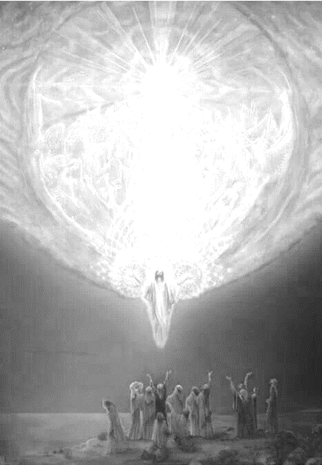
Check up
Name:____________________________
Date:____________
Draw a diagram and use words and symbols that show the relationship between the stories of Jesus’ life, death, resurrection, ascension and the coming down of his Spirit at Pentecost.
Make a flow chart that illustrates how the Holy Spirit given to the first disciples at Pentecost has continued to empower Jesus’ followers and their descendants for hundreds of year throughout the world and has been passed on to you here today in Aotearoa New Zealand.
Create a dance, movement or dramatic presentation to enable those who watch it to understand more clearly God’s plan that the Holy Spirit could continue to work in the world starting with the work Jesus did down to the present day and add how it will continue into the future. Film your presentation to share in your school and your parish.
Explain how the events of Easter and Pentecost help people to understand the meaning of the events in Jesus’ life that led up to them and the importance of knowing the sequence of the stories that are part of the Easter celebration and how they relate to the life of the Church today.
Which activity do you think helped you to learn best in this resource?
Questions I would like to ask about the topics in this resource are …
R-1
S-09
Worksheet
Click the up arrow to return to the lesson

