Slide 1
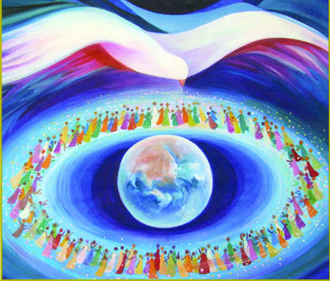
Pentecost Today
R-1
S-01
Notes:
Slide 1 Pentecost Today
Use this slide as a focussing strategy to introduce the resource topic. Read the title together and invite children to share something they know about the Feast of Pentecost.
Use the Scripture stories about Pentecost during class prayer this week.
Notice the image of the Spirit hovering over the world.

Slide 2
Learning Intentions
The students will:
1)
recall the Pentecost story
2)
identify the gifts of the Holy Spirit Te Wairua Tapu
3)
identify ways people express one of the gifts taonga
of the Holy Spirit in their lives
R-1
S-02
Click the borders to reveal text
Notes:
Slide 2 Learning Intentions
Read through the Learning Intentions with the class and identify some ideas/questions that might be explored in the resource.

Slide 3
The Life of Christ celebrated throughout the Liturgical Year
Take time to look at the image and reflect on how the life of Christ is celebrated during the Liturgical Year.
Bring into your mind something you know about each season starting with Advent.
Share your ideas and explain how the events and the seasons are connected.
Make a class list of key words and phrases about Pentecost.
X
R-1
S-03
Click the I-button to reveal information
Notes:
Slide 3 The Life of Christ celebrated throughout the Liturgical Year
Adapt Teaching and Learning Experience 1.
Keep Pentecost key words list for students to view while working on Slide 4.
Remind students the Liturgical Year starts with the season of Advent. Read and discuss the title and sub title for each feast and season.
Then work through the I pop up items to help students revise what they know
about how the life of Christ is celebrated during the Liturgical Year. Keep the list of key words for Pentecost to refer to in the next slide.

Slide 4
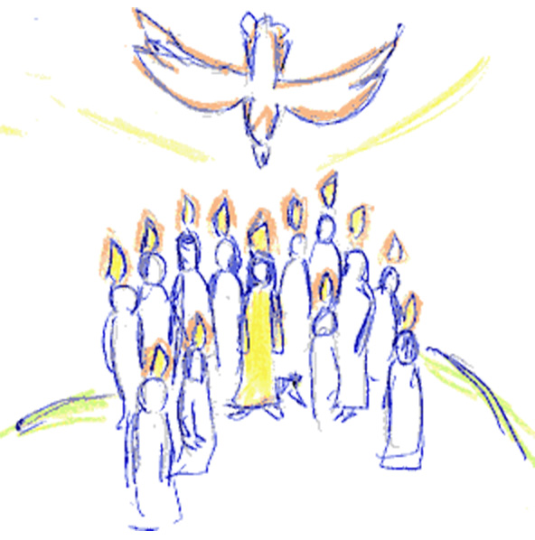
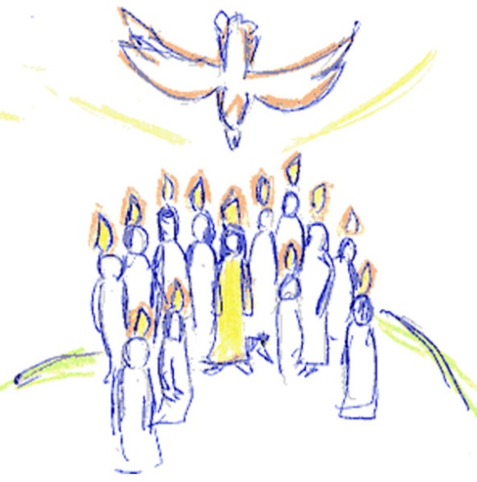
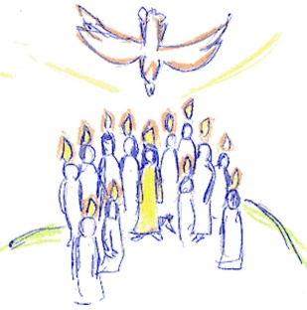
Recapping what Pentecost is about
R-1
S-04
Click on the worksheet button to go to the worksheet.
Notes:
Slide 4 Recapping what Pentecost is about
Adapt Teaching and Learning Experience 2.
Give each student a mind map to record what they know about Pentecost and what they would like to know. Refer them to the Pentecost key word list.
Treat this as a pre-test and add it to their RE Learning Journals.
In class prayer this week read the Pentecost story Acts 2:1-11.

Slide 5
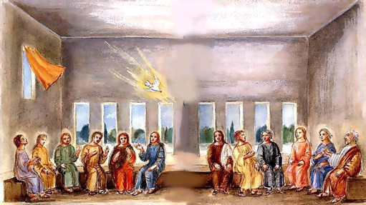
The Story of Pentecost
R-1
S-05
Click the video button to play ‘Day of Pentecost’
Notes:
Slide 5 The Story of Pentecost
Invite students to look at the image on the slide and note its style in relation to the traditional Pentecost images in the clip. Give reasons for the style you prefer. Watch the clip ‘Day of Pentecost’ 4:39 minutes.
https://www.youtube.com/watch?v=7TyCwUrR_OM
Point out Stephen in the clip and note what happened to him in Acts 7. Stephen was the first Christian martyr. Adapt Teaching and Learning Experience 3.
Students make comic strips telling the Pentecost story to share with younger children. These can be used as evidence for Check-up Item 1.

Slide 6
Why is Pentecost such a significant
event in the Church?
The PENTECOST event fulfilled the promise Jesus made to his apostles at his Ascension that he would be with them always and he made this possible through sending his Spirit. What would have happened if Jesus had not kept his promise?
The PENTECOST story is recorded in the 2nd Chapter of the Acts of the Apostles. It took place 50 days after the resurrection around 9am in the upper room where the Last Supper was shared. It coincided with Shavuot, the Jewish festival of Weeks. What was the first sign that the disciples were filled with the Holy Spirit? (Acts 2:4).
The people present at PENTECOST were about 120 followers of Christ including the 11 apostles and Matthias, who was Judas Iscariot's replacement, Jesus’ mother, Mary, and various other women disciples. Who recorded the Pentecost events in the Acts of the Apostles? Was the author an eye witness?
It was through the Holy Spirit coming down at PENTECOST and filling the first followers of Jesus with spiritual gifts that enabled the Church to be established on earth. This is why PENTECOST is recognised as the birthday of the Church. How old is the Catholic Church now?
The members of the Church down through the centuries are challenged to continue the mission or work of Jesus, using the gifts given by the spirit at the first PENTECOST to do as he did to build God’s kingdom or reign of justice tika, peace rangimarie and aroha love here on earth. How can young people of your age use the gifts the Holy Spirit has given you to be an active and faithful disciple of Jesus?
R-1
S-06
Click the top card to discard it
Notes:
Slide 6 Why is Pentecost such a significant event in the Church?
Work through the flip cards and use them to initiate discussion and research.
Note the message revealed in the centre of the image.
Invite students to give reasons why Pentecost is such a significant event in the life of the Church including:
- Without the presence of the Spirit Jesus’ mission could not have continued and the Church would not have been born.
- The Spirit poured out gifts on people that enabled them to live as Jesus lived and build his kingdom here on earth.
- The coming of the Spirit fulfilled Jesus’ promise to be with his followers always.
- Pentecost enables the Spirit to live in the world, in the Church and in our hearts guiding and prompting us to make Jesus alive in the world.

Slide 7
Pentecost in the life of the Church today
The Church today relies on the guidance of the Holy Spirit and continually prays “Come Holy Spirit, fill the hearts of your faithful and kindle in them the fire of your love. Send forth your Spirit and they shall be created and you shall renew the face of the earth.” You could include this prayer in your class prayer.
In the Sacrament of Confirmation the gifts of the Spirit are confirmed in each person to enable them to develop them and contribute to the life of the Church. Their gifts will also help them to develop loving relationships and to lead a happy and fulfilling life.
Young disciples today need to be watching for the life and work of the Spirit in the Church in people who demonstrate the gifts of the Spirit. Reflect on the people around you who use the gifts they have been given to let the power of the Spirit of Pentecost continue to inspire the Church today.
The Holy Spirit that came at Pentecost to the first members of the Church continues to work in the present day members of the Church. The gifts the Spirit poured out on the first members continue to be poured out to enable the disciples of today to carry on the mission of Jesus to build the Kingdom of God.
Click the pins on the right to reveal post-it notes.
Click the video button to play ‘We didn’t start the fire’
R-1
S-07
Notes:
Slide 7 Pentecost in the life of the Church today
Use the post it notes to stimulate discussion about:
1) The relationship between how the first disciples received the Spirit and how the Spirit is passed on to the disciples of today - in the Sacraments.
2) The effect the Spirit had on the first disciples and how it affects Jesus’ followers today.
3) How Baptism is the beginning of the life of the Spirit in people, and how Confirmation ‘confirms’ this life so people can grow in their Christian life.
4) As people grow in their Christian life they become more aware of how the Spirit ‘nudges’ them to use their gifts for the good of others and to notice how good this feels. Young people share their experiences of the nudges, prompts, hunches they recognise as the Spirit alive in their hearts.
Watch the clip https://www.youtube.com/watch?v=RMuoHudWRwo
Pentecost Parody – We didn’t start the fire 3:47 minutes
Use the clip in class and at assembly and Pentecost liturgy to share the joy of the Holy Spirit!

Slide 8
What each gift of the Holy Spirit does
WISDOM helps people to: put God first, see life from God’s point of view, love what God loves, and make wise choices and decisions.
UNDERSTANDING helps people to: appreciate the meaning of their faith, believe in God and live according to their faith, know how other people feel and be compassionate to them, and know how to live in loving relationships with God, other people and creation.
RIGHT JUDGEMENT helps people to: use their conscience well, know the difference between right and wrong according to God’s law and act on it, be open to the good advice of wise people and act on it, encourage others to live with tika, pono and aroha and help people in times of trouble.
KNOWLEDGE helps people to: grow in their knowledge of God and the teaching of Jesus, to evaluate their lives in the light of God’s love, to know who they are as sons and daughters of God, and to share their faith with others through word and action.
R-1
S-08A
Click the images to reveal text
Notes:
Slide 8A What each gift of the Holy Spirit does
Please Note - Some of the original names of the Gifts of the Spirit that were used have changed. The new titles are as follows:
Right Judgement was known as Counsel
Reverence was known as Piety
Courage was known as Fortitude Wonder and Awe was known as Fear of the Lord
Using each reveal take time to work through the text for each gift. Reflect on its meaning and invite the young people to share an experience they have had or know about when the gift was present in themselves or in someone they know that demonstrates how it looks when it is put into action.
Class could make Gifts of the Spirit bunting to share their learning in their classroom, school and church.

Slide 9
What each gift of the Holy Spirit does
COURAGE helps people to: stand up for their faith and follow Christ, to use their inner strength to do what is right even when faced with difficulties, and not give up living their Christian life even when others do.
REVERENCE helps people to: love and worship God, draw closer to God in prayer, show respect for others as sons and daughters of God, and show respect for creation recognising that every living thing is connected and the is work of God’s hands.
WONDER and AWE helps people to: appreciate the glory and mystery of God, become aware of the greatness of God, be alert to and appreciate the presence of God in everything around them in the world and to praise God for God’s love and all the marvellous things God accomplishes in their lives.
R-1
S-08B
Click the images to reveal text
Notes:
Slide 8B What each gift of the Holy Spirit does
Please Note - Some of the original names of the Gifts of the Spirit that were used have changed. The new titles are as follows:
Right Judgement was known as Counsel
Reverence was known as Piety
Courage was known as Fortitude Wonder and Awe was known as Fear of the Lord
Using each reveal take time to work through the text for each gift. Reflect on its meaning and invite the young people to share an experience they have had or know about when the gift was present in themselves or in someone they know that demonstrates how it looks when it is put into action.
Class could make Gifts of the Spirit bunting to share their learning in their classroom, school and church.

Slide 10
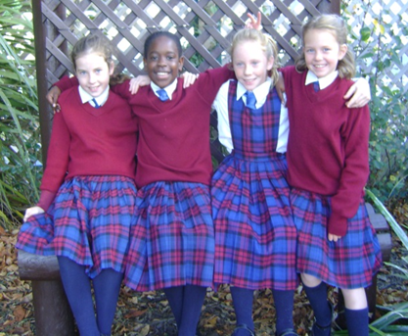
How the Gifts of the Holy Spirit help people to act like Jesus in the world
Match the correct Gift that is being expressed
Children recognising God’s presence in the beauty of a sunset and praising God for it
People participating in RE work and living their lives as God’s children
Young people putting God first and making wise choices and decisions in their lives
Children using their inner strength to do what is right even when faced with difficulties
People using their conscience well and being open to the good advice of wise people
Young people understanding their faith, believing in God and living in loving relationships
Children loving and worshipping God, showing respect for creation as the work of God’s hands
Wonder and Awe
Knowledge
Wisdom
Courage
Right Judgement
Understanding
Reverence
A ) Understanding
B ) Reverence
C ) Courage
Knowledge
Wonder and Awe
Right Judgement
Wisdom
Courage
Reverence
Understanding
D ) Wisdom
E ) Right Judgement
F ) Wonder and Awe
G ) Knowledge
Click the words in the box to reveal the solution
Click the video button to play ‘The Spirit of Pentecost’
R-1
S-09
Notes:
Slide 9 How the Gifts of the Holy Spirit help people to act like Jesus in the world
Read and match each statement with a gift of the Spirit. Click on the gift.
ANSWERS 1) F, 2) G, 3) D, 4) C, 5) E, 6) A, 7) B
Remind the students that the Gifts of the Holy Spirit are share with all the Christians Churches not just the Catholic Church.
NB Please preview this clip before showing the class.
You may need to pause the clip and discuss some points the people make depending on the maturity of the class. There are references to sexual abuse. There are some great messages for young people in this ecumenical film that illustrates how the Holy Spirit is alive in people in the Anglican church who help people who are hurt to heal, just as Jesus did.
Watch the clip
https://www.youtube.com/watch?v=Eak7H67x_TI
The Spirit of Pentecost: a short film 5:59 minutes
Adapt Teaching and Learning Experience 4.

Slide 11
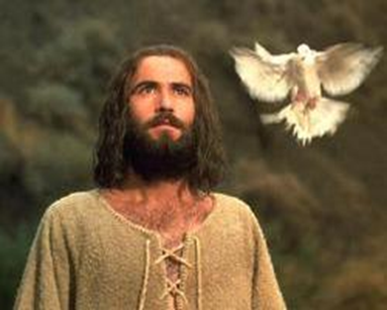
Recall stories from the Gospels when Jesus showed he lived by the gifts of the Holy Spirit
Complete the sentences to illustrate how Jesus used the gifts of the Spirit
When Jesus taught the people about God he showed …
When Jesus prayed to God his Father …
When Jesus was on trial before Pontius Pilate …
When Jesus healed people who were sick …
When Jesus used parables he taught the people about …
When Jesus praised God he …
When Jesus used creation in his teaching he …
R-1
S-10
Notes:
Slide 10 Recall stories from the Gospels when Jesus showed he lived by the gifts of the Holy Spirit
Work through the list with the class naming incidents recorded in the gospels that enable people to see the gifts of the Spirit in action in Jesus’ life. Use these stories in class prayer this week. Explain it is the Holy Spirit working in us that enables us to see the connection between the gifts of the Spirit and how we act towards others just as we can recognise this in Jesus’ words and actions. The Holy Spirit helps us to be alert to coherence and cohesion between our gifts and our ideas and actions.

Slide 12
Prayer for the Gifts of the Holy Spirit
Generous God – I ask for:
Te Wairua of Wisdom
That I may see things from your point of view and love what you love.
The Spirit of Understanding
That I may grow in understanding of your enormous love for me.
Te Wairua of Right Judgement
That I may always use my conscience to choose what is right
and be ready to listen to good advice.
The Spirit of Knowledge
That I may continue to seek to know you better and deepen
my relationship with you.
Te Wairua of Courage
That I may have the strength to stand up for what is tika
and remember you are with me always.
The Spirit of Reverence
That I may recognise your presence in my life and in all creation
as the work of your hands.
Te Wairua of Wonder and Awe
That I may grow in appreciation of your glory and greatness
and your holy presence everywhere.
With praise and thanks I pray that all honour and glory be yours forever.
AMENE
R-1
S-11
Notes:
Slide 11 Prayer for the Gifts of the Holy Spirit
When using this Prayer for the Gifts of the Holy Spirit - pray for each gift slowly and thoughtfully. Vary it by inviting groups within the class to pray for a particular gift.
Make copies of the Prayer for the Gifts of the Holy Spirit for the students.
Use the prayer in class prayer and add it to students RE Learning Journal.

Slide 13
Check up
1)
Use the comic strip on Slide 5 to retell the Pentecost story.
2)
Name the Gifts of the Holy Spirit and describe examples of how you have recognised 2 of them in people you know.
3)
Write a reflection on one of the Gifts of the Holy Spirit and how you are aware of it in your life.
4)
Explain the importance of Pentecost in the life of the Church and in those who follow Jesus today.
5)
Which activity do you think helped you to learn best in this resource?
6)
Questions I would like to ask about the topics in this resource are …
Click in each caption space to reveal text
Click on the worksheet button to go to the worksheet.
R-1
S-12
Notes:
Slide 12 Check Up
This formative assessment strategy will help teachers to identify how well students have achieved the Learning Intentions of the resource.
Teachers can choose how they use the slide in their range of assessment options.
A worksheet of this slide is available for students in Years 5-8 to complete.
The last two items are feed forward for the teacher.
Recording the students’ responses to these items is recommended as it will enable teachers to adjust their learning strategies for future resources and target the areas that need further attention.

Slide 14
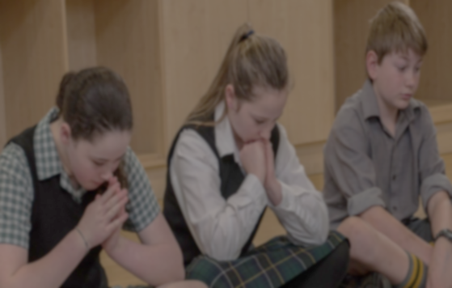
Time for Reflection
R-1
S-13
Click the audio button to stop reflective music
Click the audio button to play reflective music
Notes:
Slide 13 Time for Reflection
The MP3 is played to help create a reflective atmosphere and bring the young people to stillness and silence as the teacher invites them to reflect on the gifts of the Holy Spirit that they have and think about how they could make more use of them in their life and in their relationships with God and people.

Slide 15
Recapping what Pentecost is about
PENTECOST
Name: _______________
Date: _________
R-1
S-04
Worksheet
Click the up arrow to return to the lesson

Slide 16
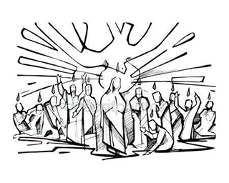
Prayer for the Gifts of the Holy Spirit
Generous God – I ask for:
Te Wairua of Wisdom
That I may see things from your point of view and love what you love.
The Spirit of Understanding
That I may grow in understanding of your enormous love for me.
Te Wairua of Right Judgement
That I may always use my conscience to choose what is right
and be ready to listen to good advice.
The Spirit of Knowledge
That I may continue to seek to know you better and deepen
my relationship with you.
Te Wairua of Courage
That I may have the strength to stand up for what is tika
and remember you are with me always.
The Spirit of Reverence
That I may recognise your presence in my life and in all creation
as the work of your hands.
Te Wairua of Wonder and Awe
That I may grow in appreciation of your glory and greatness
and your holy presence everywhere.
Name: _______________
Date: _________
With praise and thanks I pray that all honour and glory be yours forever. AMENE
R-1
S-11
Worksheet
Click the up arrow to return to the lesson

Slide 17
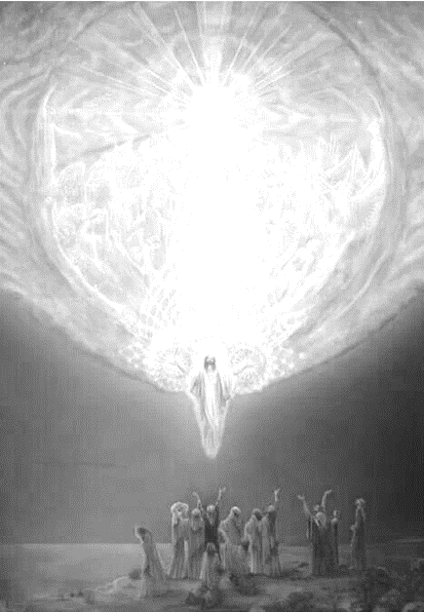
Check up
Name:____________________________
Date:____________
Use the comic strip on Slide 5 to retell the Pentecost story.
Name the Gifts of the Holy Spirit and describe examples of how you have recognised 2 of them in people you know.
Write a reflection on one of the Gifts of the Holy Spirit and how you are aware of it in your life.
Explain the importance of Pentecost in the life of the Church and in those who follow Jesus today.
Which activity do you think helped you to learn best in this resource?
Questions I would like to ask about the topics in this resource are …
R-1
S-12
Worksheet
Click the up arrow to return to the lesson

